Slide 1
Project 3
Exploratory Data Analysis

Slide 2
What is EDA(Exploratory Data Analysis)?
Exploratory Data Analysis (EDA) is a crucial first step in data science projects, where data is examined and visualized to understand its characteristics, identify patterns, and uncover insights.
It helps data scientists summarize data, detect anomalies, and test hypotheses before delving into more advanced statistical analysis or model building.
In essence, EDA is a data discovery process that allows data scientists to gain a deeper understanding of their data before proceeding with more formal analysis or modeling.

Slide 3
Why is EDA Important?
EDA can reveal issues like missing values, inconsistent data formats, or outliers that need to be addressed before further analysis.
EDA can reveal issues like missing values, inconsistent data formats, or outliers that need to be addressed before further analysis.
EDA can reveal issues like missing values, inconsistent data formats, or outliers that need to be addressed before further analysis.
Understanding Data:
EDA helps data scientists get a feel for the data's structure, distribution, and relationships between variables.
Identifying Patterns:
It uncovers hidden patterns, trends, and connections within the data that might not be immediately obvious.
Detecting Anomalies:
EDA helps identify outliers or unusual data points that could be errors or require further investigation.
Formulating Hypotheses:
The insights gained from EDA can lead to the formulation of testable hypotheses for more formal analysis.
Data Cleaning and Preparation:
EDA can reveal issues like missing values, inconsistent data formats, or outliers that need to be addressed before further analysis.

Slide 4
Project Name: House Prices Analysis
We are given a dataset having different parameters like, year built, month sold, year sold, sale price, etc.
We will use various exploratory data analysis techniques and take ou meaning insights from it.
At first will call all the important libraries such as numpy, pandas, matplotlib, seaborn, etc required for analysis.

Slide 5

Dropping Duplicate Values
Duplicate values adds obstruction in data analysis.
This duplicate values will disturb the overall dataset and will provide incorrect insights from the dataset.
Hence it is important to drop all the duplicate values from the dataset.

Slide 6

Handling Missing Values
Same as duplicate values missing values also create obstacle in data analysis.
As we can see in the image there is a wall where some bricks are, which decreases the overall strength of the wall, hence we have to fill the missing bricks in order to provide the overall strength to the wall.
In same order we also have to replace the missing values with some meaningful data like mean in order to have proper analysis.

Slide 7

Handling outliers
An outlier in a dataset is a data point that significantly deviates from the rest of the data, often appearing as a value much higher or lower than the majority of the other values.
Outlier also creates obstacle in data analysis and gives out incorrect insights in data.
In order to analyze data properly we usually replace outliers with upper limit or lower limit for correct insights from the data

Slide 8
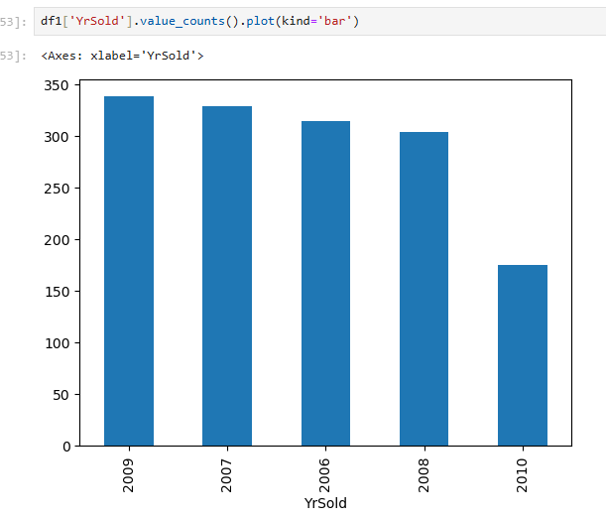
Year Sold of house
In the Given graph x axis tells us about the year of selling of house, and y axis represents the total count of houses sold that year.
This is an example of univariate analysis as there is only one component used for analysis.
From the graph we can infer that the number of house sold per year is decreasing as the year progresses.

Slide 9
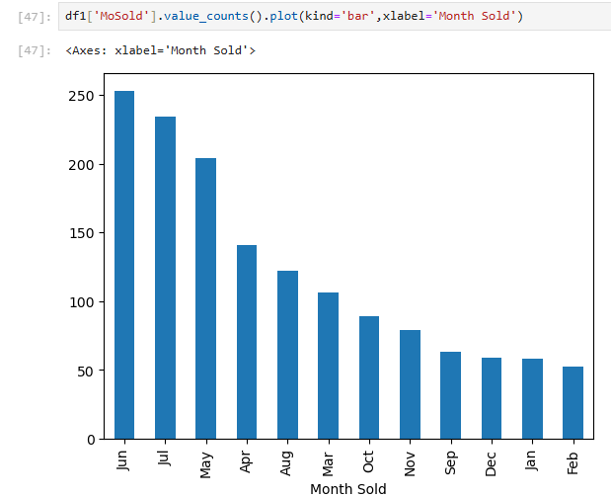
Month of House Sold
In the Given graph x axis tells us about the month of selling of house, and y axis represents the total count of houses sold that month.
This is an example of univariate analysis as there is only one component used for analysis.
From the graph we can see that peak house selling period is in the month of June, July and May.

Slide 10
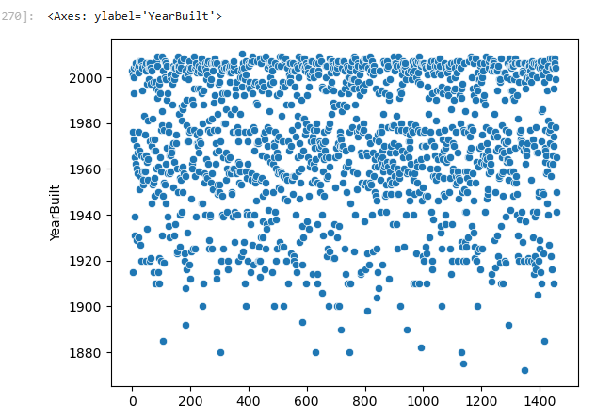
Year Built of House
In the Given graph y axis tells us about the year of building of house, and x axis represents the total count of houses built that month.
This is an example of univariate analysis as there is only one component used for analysis.
From the graph we can infer that most of the houses were built during 1960 - 2000

Slide 11
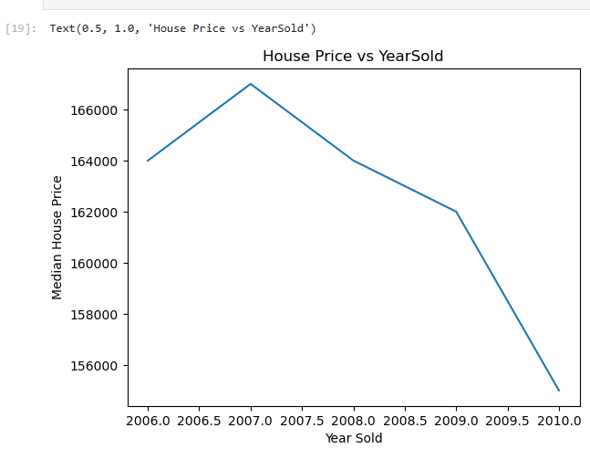
Bivariate Data Analysis
In the Given graph x axis tells us about the year of selling of house, and y axis represents the average selling price of houses that year.
This is an example of bivariate analysis as there are two components used for analysis.
The graph shows that the average selling price of house is monotonous, it gets increases as the year progresses to some extent but later there is steep fall in the prices of house as year progresses.

Slide 12
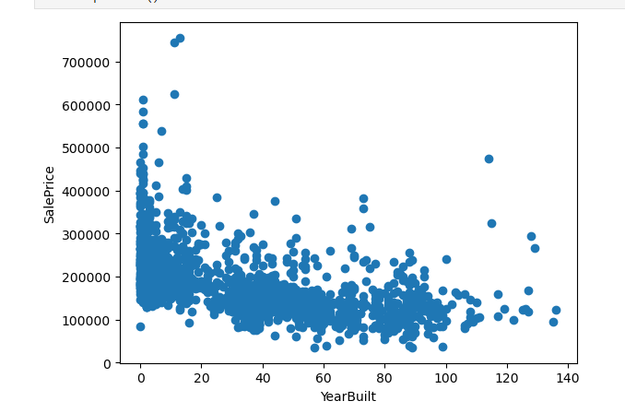
Bivariate Data Analysis
In the Given graph x axis tells us about After how many years the house was sold, and y axis represents the average selling price of houses that year.
This is an example of bivariate analysis as there are two components used for analysis.
From the graph we can infer that if the age of house is less it has greater selling price and vice versa

Slide 13
Insights from the data sets
The number of houses sold per year is decreasing as the year progresses.
The peak house selling period is in the months of June, July and May.
Most of the houses are built during the period of 1960 – 2000.
The price of houses rise for a particular period but later there was a steep fall in the prices of the houses as the year progresses.
The selling price of house is high if the age of house is less and vice versa.

Slide 14

Reasons Behind Insights
The number of houses sold is decreasing, this may be due to less amenities nearby and less development of the area.
The price of houses is decreasing even after year progresses, this may be due to the age of houses is more and the style of house built may be old which discourages the buyer to buy the house.
If there will be less development in the area then there will be less chance for creation of jobs, this factor also contributes in decrease of prices of houses

Slide 15
Thank You

